Slide 1
Section 5.4 Indefinite Integrals and the
Net Change Theorem

Slide 2
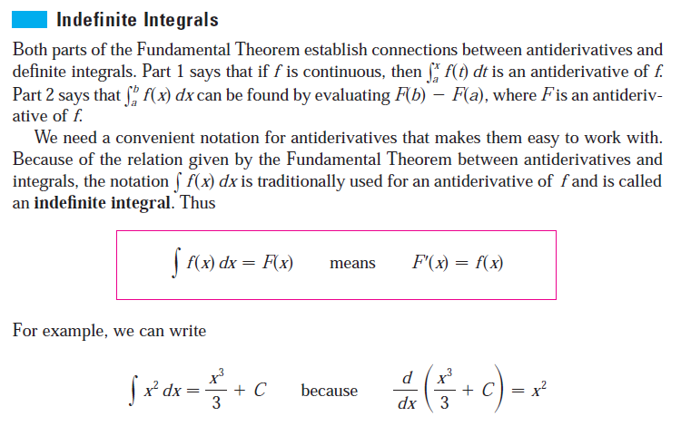

Slide 3
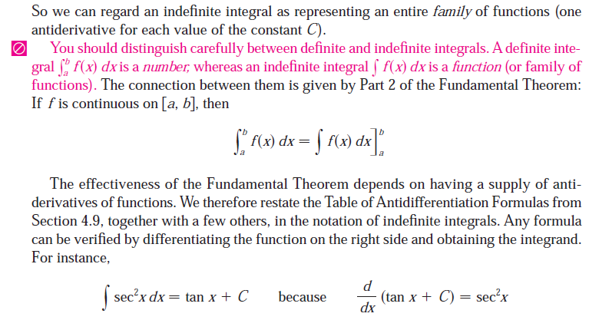

Slide 4
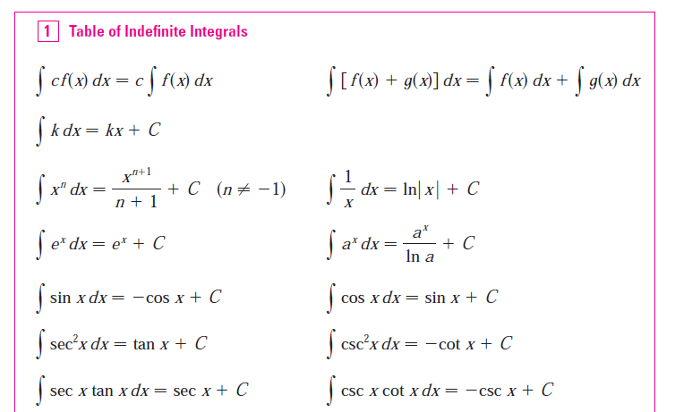

Slide 5
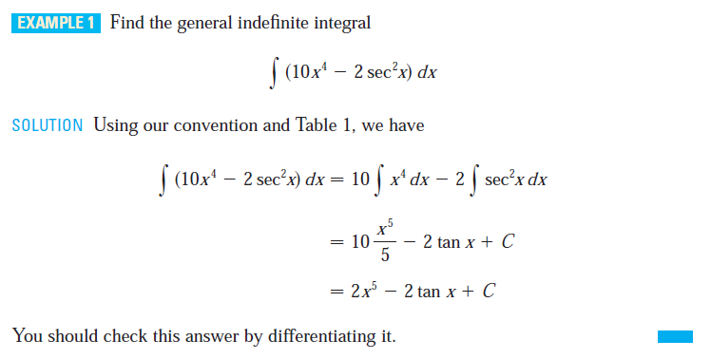
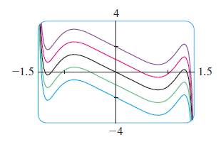
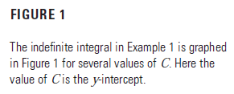

Slide 6
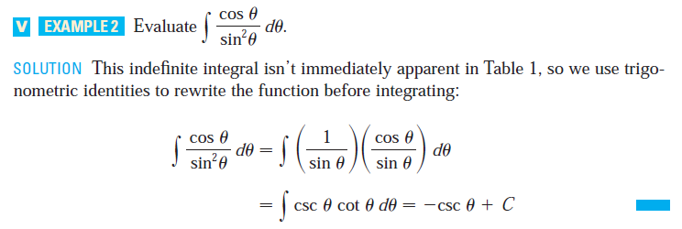
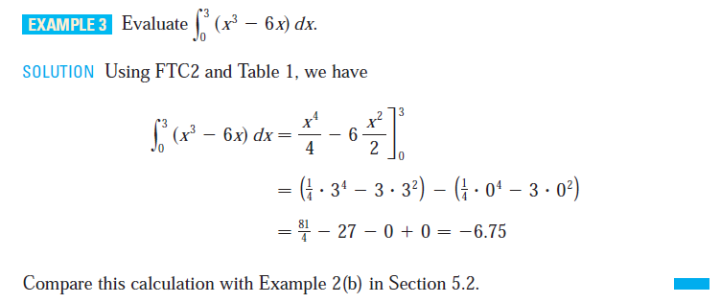

Slide 7
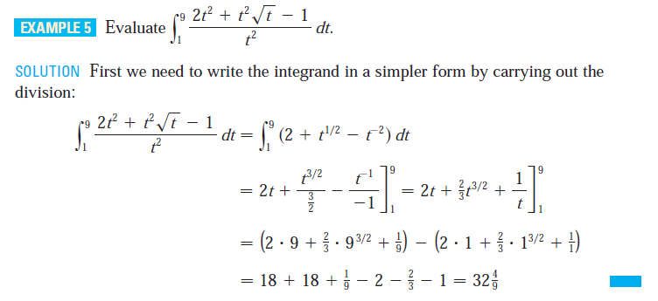

Slide 8
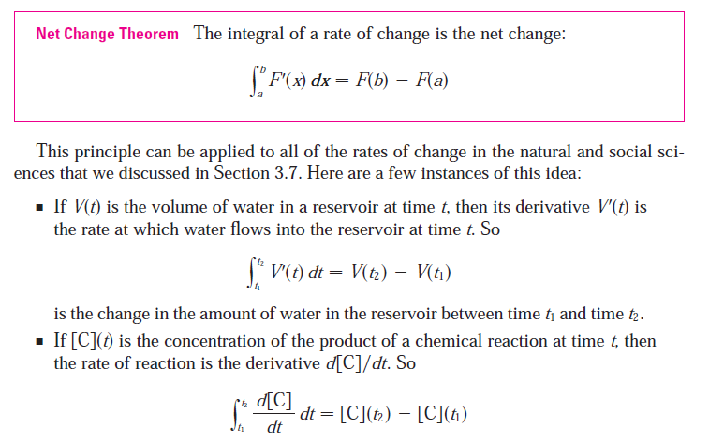

Slide 9
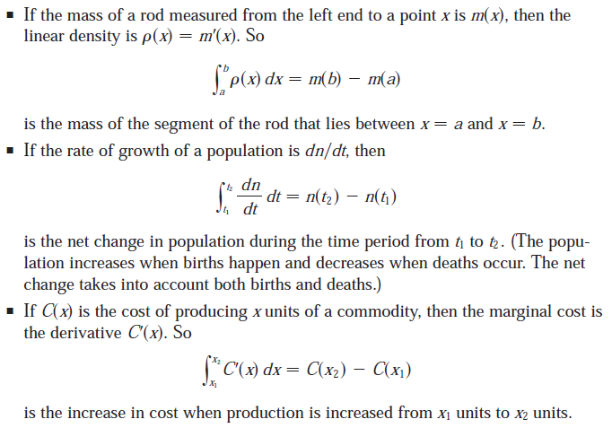

Slide 10
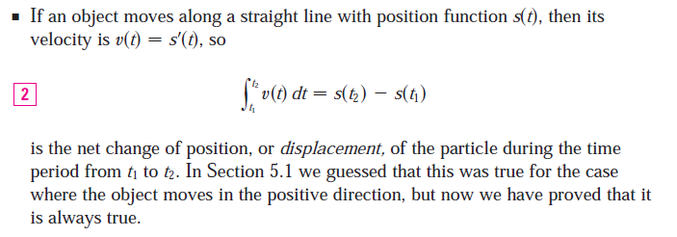

Slide 11
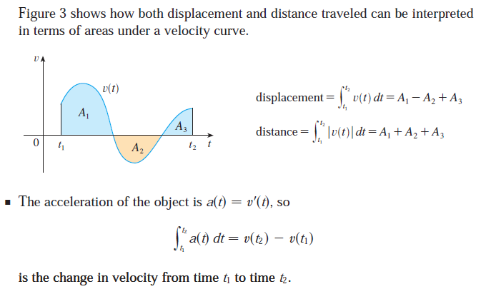

Slide 12
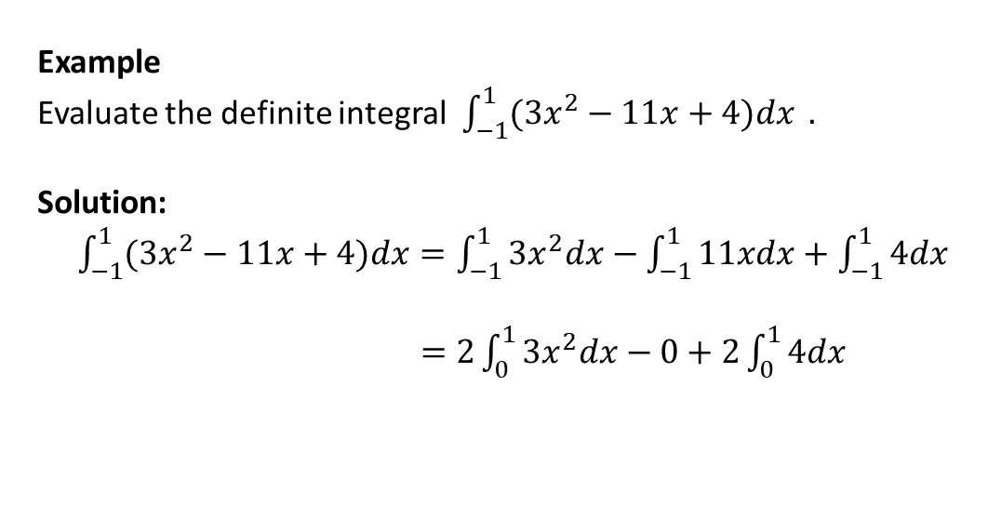
Important properties of Even and Odd functions
Let a be a positive number, and $f\left(x\right)$be a continuous function on the interval [-a, a], then
(1) if $f\left(x\right)$is an even function, then $\int_{−a}^{a}{f\left(x\right)dx}=2\int_{0}^{a}{f(x)dx}$,
(2) if $f(x)$is an odd function, then $\int_{−a}^{a}{f\left(x\right)dx }=0.$
Example
Evaluate the definite integral $\int_{−1}^{1}{(3x^{2}−11x+4)dx} .$
Solution: $\int_{−1}^{1}{(3x^{2}−11x+4)dx}=\int_{−1}^{1}{3x^{2}dx}−\int_{−1}^{1}{11xdx}+\int_{−1}^{1}{4dx}$
$=2\int_{0}^{1}{3x^{2}dx}−0+2\int_{0}^{1}{4dx}$

Slide 13
